Slide 1
SMART BLIND STICK
WAGISHA RAJ SINGH ROLL NO. EL201611246
UTSAV RANJAN ROLL NO. EL201618249
BRAJRAJ CHOUDHARY ROLL NO. EL201610250
SIDDHARTH KUMAR ROLL NO. EL201610263
HIMANSHU SHEKHAR ROLL NO.EL201610289
RAHUL KUMAR PATNAIK ROLL NO.EL201610273
Under the guidance of
MRUTYUNJAYA MANGARAJ

Slide 2
ABSTRACT
This Smart stick will have an Ultrasonic sensor to sense distance from any obstacle, LDR to sense lighting conditions and a RF remote using which the blind man could remotely locate his stick. All the feedbacks will be given to the blind man through a Buzzer.

Slide 3
INTRODUCTION
“I CANNOT CHANGE THE DIRECTION OF THE WIND, BUT I CAN ADJUST MY SAILS TO ALWAYS REACH MY DESTINATION” -JIMMY DEAN.
So yes ,technology can indeed neutralize human disability, with this in mind let us use the power of ARDUINO and some SENSORS to build a Blind Man’s Stick that could perform more than just a stick for visually impaired person.

Slide 4
COMPONENTS USED
Ardurino
Ultrasonic Sensor HC-SR04
LDR
Buzzer and LED
7805
433MHz RF transmitter and receiver
Resistors(4.7k,10k)
Push button
APB
Soldering Kit
9V batteries

Slide 5
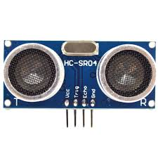
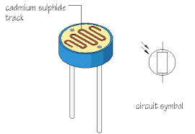
Component Used
Ultrasonic Sensor- it is used to measure the distance to an object using sound waves.
Light Dependent Resistor(LDR )- it has variable resistance that changes with the light intensity that falls upon it.

Slide 6
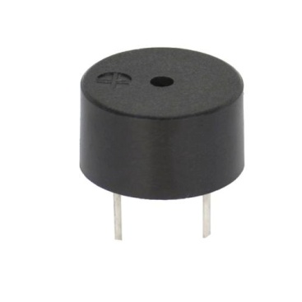
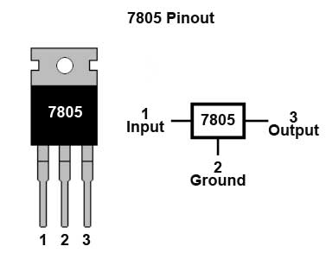
Component used
Buzzer(PIEZO)-it is an audio signalling device.
7805- it is a voltage regulator used to convert 12v to 5 volt.

Slide 7
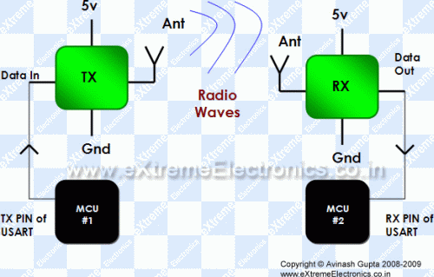
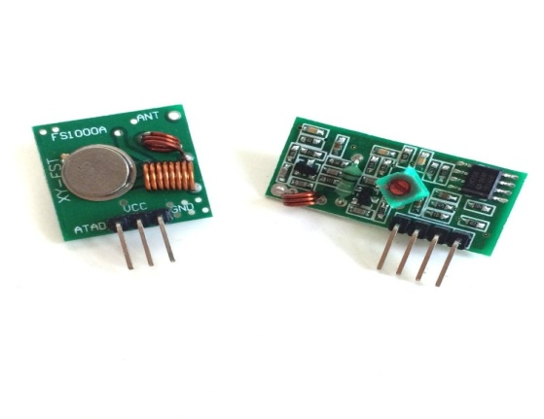
Component Used
RF module- radio frequency module, basically used to build a wireless connection between two point.
- it consist of two unit one is transmitter and other is reciever unit.

Slide 8
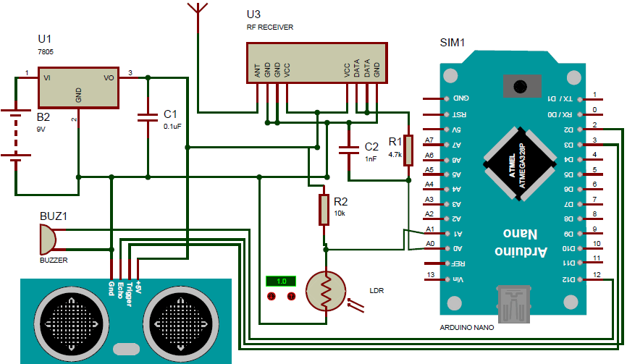
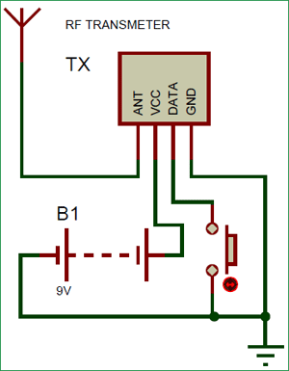
Circuit diagram

Slide 9
Working
This Arduino Smart Blind Stick Project requires two separate circuits. One is the main circuit which will be mounted on the blind man’s stick. The other is a small remote RF transmitter circuit which will be used to locate the main circuit.
Arduino is used to control all the sensors. The complete board is powered by a 9V battery which is regulated to +5V using a 7805 Voltage regulator.

Slide 10
Working
The Ultrasonic sensor is powered by 5V and the trigger and Echo pin is connected to Arduino pin 3 and 2.
The LDR is connected with a resistor of value 10K to form a Potential divider and the difference in voltage is read by Arduino ADC pin A1.
The ADC pin A0 is used to read the signal from RF receiver. The output of the board is given by the Buzzer which is connected to pin 12.

Slide 11
Working
433 MHz module requires the receiver to detect if the transmitter is sending some signals. So the Data pin of the transmitter is connected to Ground or Vcc of the supply.
The data pin of the receiver is passed through an RC filter and then given to the Arduino. Now, whenever the button is pressed the Receiver output some constant ADC value repeatedly. So we write the Arduino program to check for repeated values to detect if the button is pressed. So that is how a Blind person can track his stick.

Slide 12
OUTCOME
Independence is the building methodology in achieving dreams goals and objective in lives, so the main purpose of this project is to produce a prototype that can
1.detect object or obstacles in front of users,
2. sense lighting and,
3. locate the stick.
It will guide the users so that they don’t have to depend on any other person .

Slide 13
WORKING TILL DATE
Implemented the model of blind stick using ARDUINO, US SENSOR, LDR SENSOR, and BUZZER only.
Total Coding part has not bin finished yet but, distance measurement using ultrasonic sensor has bin tested successfully and it’s working.

Slide 14
Thank You

